Slide 1
Computer Organization & Architecture
Dr. Hammad Afzal
Military College of Signals
National University of Sciences and Technology, Pakistan
Fall, 2010
hammad.afzal@mcs.edu.pk
https://sites.google.com/a/mcs.edu.pk/codteem/
Dr: HammaD AfzaL - Computer Organization and Architecture

Slide 2
1. Introduction to Architecture & Organization
2. Computer Evolution & Performance
Dr: HammaD AfzaL - Computer Organization and Architecture

Slide 3
Agenda
Course Details
Introduction
Dr: HammaD AfzaL - Computer Organization and Architecture

Slide 4
Course Objective
The objective of this course is to study computer architecture design by examining architectural concepts with consideration of performance, usability, reliability, power management etc.
This course covers a number of topics such as Instruction Set Architecture, Pipeline Microprocessor, Memory Organization and Management, I/O Management, Interrupt Handler etc to give deep insight about the computer architecture to the students.
Dr: HammaD AfzaL - Computer Organization and Architecture

Slide 5
Resources
Lecture Slides will be available on my website:
https://sites.google.com/a/mcs.edu.pk/codteem/teaching/coa
Quizzes and Assignments will also appear on my website:
With each lecture, additional references shall be provided.
Text Book:
1. Computer Organization and Architecture by William Stallings.
Reference:
1. Computer Architecture & Organization by A.J. Van De Goor.
2. Computer Architecture and Organization by John P. Hayes, 3rd Edition, McGraw-Hill.
3. Computer System Architecture by M. Morris Mano, Third Edition
Dr: HammaD AfzaL - Computer Organization and Architecture

Slide 6
Grading Policy
Assignments/Case Studies 10%
Quizzes 10%
Mid Terms 30%
End-term 50%
Assignments
  To be announced later
Quizzes
  Mostly unannounced
  Occasionally announced
Dr: HammaD AfzaL - Computer Organization and Architecture

Slide 7
Assignment Policies
No late work will be accepted (unless arrangements have been made in advance)
Dr: HammaD AfzaL - Fundamentals of Programming

Slide 8
Policies – Attendance
Deficiency in attendance may lead to termination or relegation
Dr: HammaD AfzaL - Fundamentals of Programming

Slide 9
Policies
Check your email regularly for messages
Course Senior:
  Make list of emails of all students
Dr: HammaD AfzaL - Fundamentals of Programming

Slide 10
A Brief Outline
Overview of Computer Organization and Architecture
Evolution of Computers
Dr: HammaD AfzaL - Computer Organization and Architecture

Slide 11
Input -> Process -> Output model
Computer system is suppose to perform a useful operation, such as word processing, retrieval and manipulation of data, bookkeeping, etc.
  i.e. a credit card transaction operation
Regardless of the type of operation to be performed, the work of a computer can be characterized as an input->process->output model:
  the program retrieves input from a disk file, mouse, keyboard or other type of input,
  processes the input
  produces the output to a disk, terminal, printer or some other type of output device
All of the above operations are repetitive in nature

Slide 12
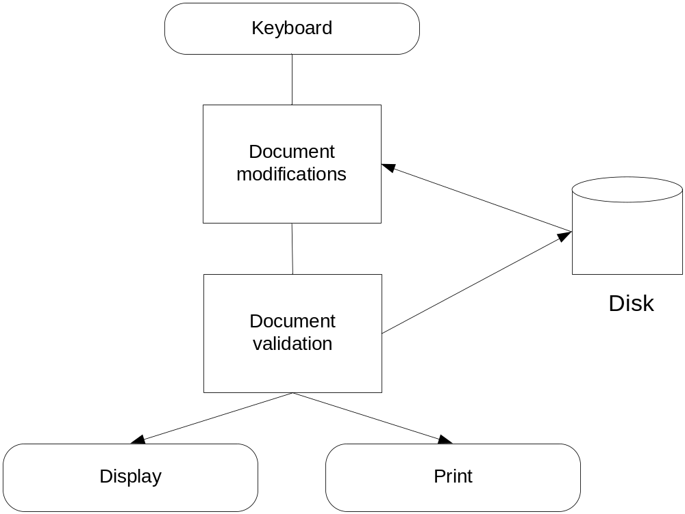
File Edit Workflow

Slide 13
Computing System Components
Hardware – provides the physical mechanisms to input and output data, manipulating data and controlling the various input, output, storage and communication components
Software – both application and system, which provides instructions that tell the hardware exactly what tasks are to be performed and in what order
Data being manipulated – can be alphanumeric, graphic or any other form. In all cases it is represented in a form that the computer will understand and manipulate

Slide 14
Architecture & Organization 1
Architecture is those attributes visible to the programmer
  Instruction set, number of bits used for data representation, I/O mechanisms, addressing techniques.
  e.g. Is there a multiply instruction?
Organization refers to the operational units and their interconnections that realize the architectural specifications
  Hardware details transparent to programmer such as Control signals between different functional units, interfaces, memory technology.

Slide 15
Architecture & Organization 1
It is an architectural issue whether a computer will have or not a specific instruction (i.e. multiply),
but it is an organization issue whether that instruction will be implemented by a special arithmetic unit or it will be implemented using the adder of the system by repetitive add operations.

Slide 16
Structure & Function
The computer is a hierarchical system, each level of which is characterized by structure and function:
  Structure: the way the components are interconnected
  Function: the operation of each individual component as part of the structure

Slide 17
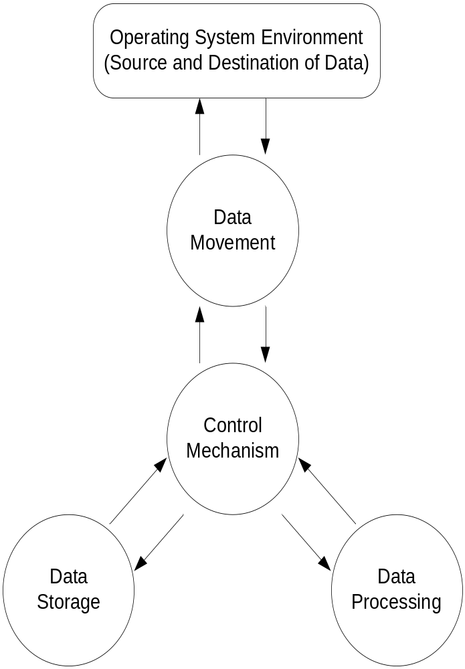
Computing Systems Function
Data Processing
Data Storage
  Short term storage
  Long term storage
Data Movement
  Input/Output for devices directly connected
  Data communication for moving data over long distances
Control
Notes:
The computer should be able to process the data. The data may take a wide variety of forms and the range of processing requirements is broad. However, we shall see that there are only fundamental methods or types of data processing.
It is essential that a computer is able to store data. Even if the computer is processing data on the fly, then the computer must store at least those pieces of data that are worked at any given moment during the processing time. Therefore, there is at least short term data storage function. Equally important, the computer performs a long term data storage function. Files or data are stored on the computer for subsequent retrieval and update.
The computer must be able to move data between itself and the outside world. The computer’s operating system environment consists of devices that servers as either sources or destinations of data. When data is received from or delivered to a device that is directly connected to a computer, the process is known as Input/output, and the device is known as a peripheral. If data is moved over long distances, the process is known as data communication.
There must be a control of those functions. Two types of control is involved: control from individuals (who provide the computing system with instructions of what to perform) and internal control (control unit manages the computer’s internal resources and internal components in response to instructions from the individuals).

Slide 18
Structure - Top Level
Peripherals
Computer
Central
Processing
Unit
Main
Memory
Computer
Systems
Interconnection
Input
Output
Communication
lines

Slide 19
Structure - The Control Unit
Control Unit
CPU
ALU
Sequencing
Logic
Internal
Bus
Control
Unit
Control Unit
Registers and
Decoders
Registers
Control
Memory

Slide 20
A brief Outline of the Course (1)
Introduction
Computer Evolution and Performance
Computer Interconnection Structures
Internal Memory
External Memory
Input/Output
Operating Systems Support
Computer Arithmetic
Instruction Sets

Slide 21
A brief Outline of the Course(2)
CPU Structure and Function
Control Unit Operation
Micro-programmed Control

Slide 22
Computer Evolution
&
Performance

Slide 23
Electronic Numerical Integrator And Computer (ENIAC)
The first completely electronic, general purpose analytical calculator.
  Addition took 200Us, Division 6ms
University of Pennsylvania
Trajectory tables for weapons
Started 1943
Finished 1946
  Too late for war effort
Used until 1955

Slide 24
ENIAC - details
Decimal (not binary)
20 accumulators of 10 digits
Programmed manually by switches
18,000 vacuum tubes
30 tons
15,000 square feet
140 kW power consumption
5,000 additions per second

Slide 25

Vacuum Tubes - 1941 - 1956
First Generation Electronic Computers used Vacuum Tubes
Vacuum tubes are glass tubes with
circuits inside.
Vacuum tubes have no air inside of them, which protects the circuitry.

Slide 26
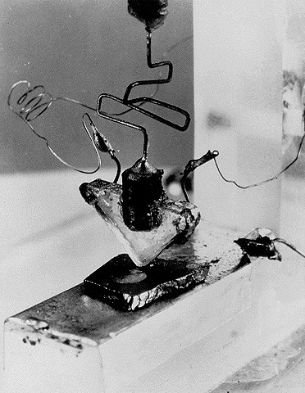
First Transistor
Uses Silicon
developed in 1948
won a Nobel prize
on-off switch
Second Generation Computers used Transistors, starting in
1956

Slide 27
Generations of Computer
Vacuum tube - 1946-1957
Transistor - 1958-1964
Small scale integration - 1965 on
  Up to 100 devices on a chip
Medium scale integration - to 1971
  100-3,000 devices on a chip
Large scale integration - 1971-1977
  3,000 - 100,000 devices on a chip
Very large scale integration - 1978 -1991
  100,000 - 100,000,000 devices on a chip
Ultra large scale integration – 1991 -
  Over 100,000,000 devices on a chip

Slide 28
Integrated Circuits
Third Generation Computers used Integrated Circuits (chips).
Integrated Circuits are transistors, resistors, and capacitors integrated together into a single “chip”

Slide 29
von Neumann/Turing
Stored Program concept
Main memory storing programs and data
ALU operating on binary data
Control unit interpreting instructions from memory and executing
Input and output equipment operated by control unit
Princeton Institute for Advanced Studies
  IAS
Completed 1952

Slide 30

Structure of von Neumann machine

Slide 31
IAS - details
1000 x 40 bit words
  Binary number
  2 x 20 bit instructions
Set of registers (storage in CPU)
  Memory Buffer Register
  Memory Address Register
  Instruction Register
  Instruction Buffer Register
  Program Counter
  Accumulator
  Multiplier Quotient

Slide 32
Third Generation – 1964-1971
1964-1971
Integrated Circuit
Operating System
Getting smaller, cheaper

Slide 33

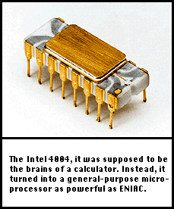
The First Microprocessor – 1971
The 4004 had 2,250 transistors
four-bit chunks (four 1’s or 0’s)
108Khz
Called “Microchip”

Slide 34
Moore’s Law
Increased density of components on chip
  Gordon Moore – co-founder of Intel
Number of transistors on a chip will double every year
Since 1970’s development has slowed a little
  Number of transistors doubles every 18 months
Cost of a chip has remained almost unchanged
Higher packing density means shorter electrical paths, giving higher performance
Reduced power and cooling requirements
Fewer interconnections increases reliability

Slide 35
Intel
1971 - 4004
  First microprocessor
  All CPU components on a single chip
  4 bit
Followed in 1972 by 8008
  8 bit
  Both designed for specific applications
1974 - 8080
  Intel’s first general purpose microprocessor

Slide 36
Intel – 80x86
1978 - 8086 (5, 8, 10MHz)
  16-bit
  29,000 transiators
  1 MB
1979 - 8088
  8-bit data width
  Both designed for specific applications
1982 - 80286(6-12.5MHz)
  16-bit
  16MB
  1GB Virtual Memory

Slide 37
Intel - Pentium
1985 - 80386 (16-33MHz) SX and DX
  32-bit
  275,000 transiators
  4GB, 64TB Virtual Memory
1989 - 80486(25-50MHz) SX and Dx
  32-bit data width
  1.2 million transistors
1993 - Pentium(60-166MHz)
  32-bit/32-bit bus
  3.1 million transistors
1995 Pentium Pro, 1997 Pentium II,
1999 Pentium III, Merced(IA-64)

Slide 38
Speeding it up
Pipelining
On board cache
On board L1 & L2 cache
Branch prediction
Data flow analysis
Speculative execution

Slide 39
Performance Balance
Processor speed increased
Memory capacity increased
Memory speed lags behind processor speed

Slide 40
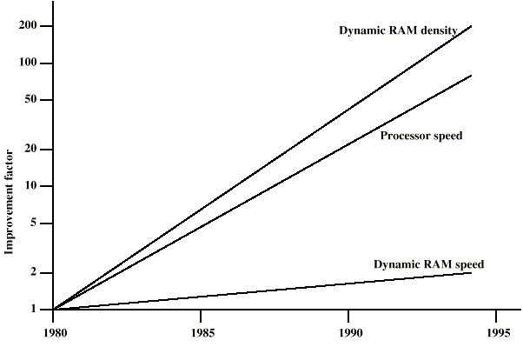
DRAM and Processor Characteristics

Slide 41
Solutions
Increase number of bits retrieved at one time
Use Cache
Reduce frequency of memory access
  More complex cache and cache on chip
Increase interconnection bandwidth
  High speed buses
  Hierarchy of buses

Slide 42
I/O Devices
Peripherals with intensive I/O demands
Large data throughput demands
Processors can handle this
Problem moving data
Solutions:
  Caching
  Buffering
  Higher-speed interconnection buses
  More elaborate bus structures
  Multiple-processor configurations

Slide 43
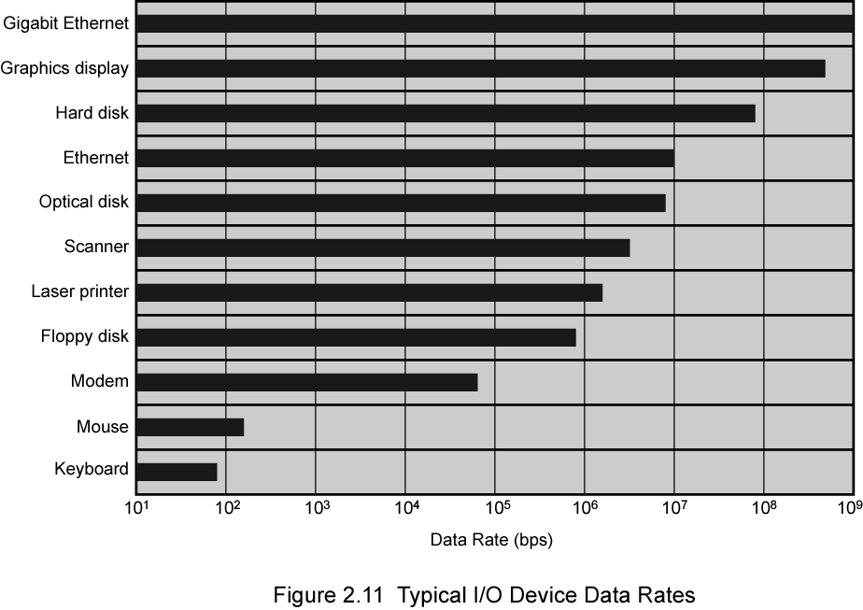
Typical I/O Device Data Rates

Slide 44
Key is Balance
Processor components
Main memory
I/O devices
Interconnection structures

Slide 45
Improvements in Chip Organization and Architecture
Increase hardware speed of processor
  Fundamentally due to shrinking logic gate size
    More gates, packed more tightly, increasing clock rate
    Propagation time for signals reduced
Increase size and speed of caches
  Dedicating part of processor chip
    Cache access times drop significantly
Change processor organization and architecture
  Increase effective speed of execution
  Parallelism

Slide 46
Increased Cache Capacity
Typically two or three levels of cache between processor and main memory
Chip density increased
  More cache memory on chip
    Faster cache access
Pentium chip devoted about 10% of chip area to cache
Pentium 4 devotes about 50%

Slide 47
More Complex Execution Logic
Enable parallel execution of instructions
Pipeline works like assembly line
  Different stages of execution of different instructions at same time along pipeline
Superscalar allows multiple pipelines within single processor
  Instructions that do not depend on one another can be executed in parallel

Slide 48
Diminishing Returns
Internal organization of processors complex
  Can get a great deal of parallelism
  Further significant increases likely to be relatively modest
Benefits from cache are reaching limit
Increasing clock rate runs into power dissipation problem
  Some fundamental physical limits are being reached

Slide 49
New Approach – Multiple Cores
Multiple processors on single chip
  Large shared cache
Within a processor, increase in performance proportional to square root of increase in complexity
If software can use multiple processors, doubling number of processors almost doubles performance
So, use two simpler processors on the chip rather than one more complex processor
With two processors, larger caches are justified
  Power consumption of memory logic less than processing logic

Slide 50
x86 Evolution (1)
8080
  first general purpose microprocessor
  8 bit data path
  Used in first personal computer – Altair
8086 – 5MHz – 29,000 transistors
  much more powerful
  16 bit
  instruction cache, prefetch few instructions
  8088 (8 bit external bus) used in first IBM PC
80286
  16 Mbyte memory addressable
  up from 1Mb
80386
  32 bit
  Support for multitasking
80486
  sophisticated powerful cache and instruction pipelining
  built in maths co-processor

Slide 51
x86 Evolution (2)
Pentium
  Superscalar
  Multiple instructions executed in parallel
Pentium Pro
  Increased superscalar organization
  Aggressive register renaming
  branch prediction
  data flow analysis
  speculative execution
Pentium II
  MMX technology
  graphics, video & audio processing
Pentium III
  Additional floating point instructions for 3D graphics

Slide 52
x86 Evolution (3)
Pentium 4
  Further floating point and multimedia enhancements
Core
  First x86 with dual core
Core 2
  64 bit architecture
Core 2 Quad – 3GHz – 820 million transistors
  Four processors on chip

Slide 53
Enough for Today

